Slide 1
Scope &
Preliminary Concepts
March 6, 2024

Slide 2
The leaders of California’s education and workforce agencies–working with students, families, adult learners, workers, employers, labor, and community-based organizations–have developed a set of big ideas for creating more equitable access to living wage, fulfilling work. During 2024, Californians will have an opportunity to weigh in on how to translate those ideas into concrete actions.
This collaborative effort will result in a Master Plan for Career Education.
Notes:
Ben

Slide 3
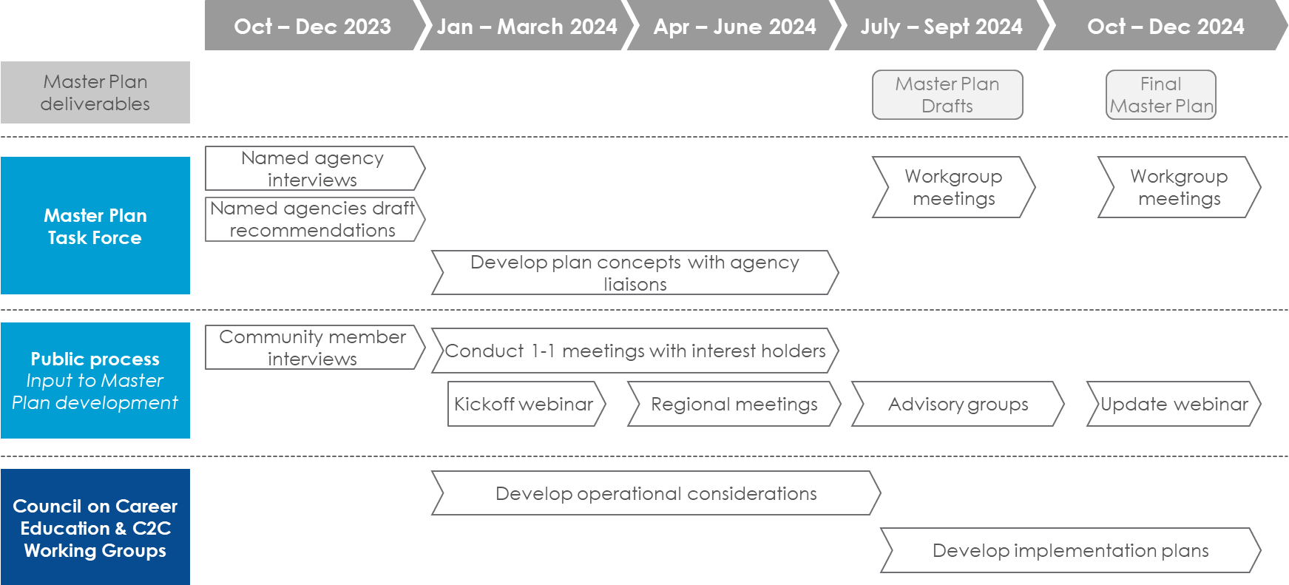
Master Plan Development Process
Notes:
Michael

Slide 4
Developing the Preliminary Concepts
These ideas are based on:
Written recommendations from the agencies named in Executive Order N-11-23*
Public input
30 interviews with named agencies and other interest holders (including legislative staff)
Recommendations on similar topics such as the California State Plan for Career Education and the Student Transfer Achievement Reform Act of 2021
* Governor's Office of Business and Economic Development, California Department of Education, California Community Colleges, California Labor and Workforce Development Agency, California State University, Department of Rehabilitation, State Board of Education, and University of California.
Notes:
Kathy

Slide 5
Community Engagement
Seven regional convenings + one virtual session where community members are helping design specific solutions for the core concepts (March-May)
Southern Border
LA/OC
Inland Empire
Central Valley
Greater Sacramento
Far North/Redwood Coast
Bay Area
Five advisory groups that will give input on the draft solutions (July-August)
Students & Families
Policy Makers & Advocates
Employers & Labor Representatives
Workforce Development Entities
Educators
Direct engagement through making presentations, joining listening sessions, and reviewing written recommendations
Notes:
Kathy

Slide 6
Preliminary Concepts: Coordination
Create both a state career coordination body and regional career councils made up of both education and workforce entities that set priorities and allocate funding related to educational attainment and career education
Designate statewide entities to provide information to support decision making, including labor market and disaggregated data on education and workforce attainment
Coordinate technical assistance provided to education and workforce entities
Notes:
Kathy

Slide 7
Preliminary Concepts: Skills Pathways
Establish aligned, skills-based model pathways in priority sectors
Create structures for all students to engage in career exploration and work based learning starting in middle school, and strengthen career services for adults
Create a shared mechanism for evaluating equivalencies between learning systems, rebuild eTranscript California to document learning from multiples contexts as academic credit
Coordinate offerings across segments to meet labor market demand
Address structural issues to improve teacher preparation pathways
Notes:
Kathy

Slide 8
Preliminary Concepts: Work Based Learning
Create strong incentives for employer participation and coordinate work based learning at the regional level
Offer academic credit for work based learning and expand paid internships
Align service learning, research, and fellowship programs with specific career pathways
Notes:
Kathy

Slide 9
Preliminary Concepts: Access
Strengthen mechanisms that encourage families to access benefits that support college savings
Expand state financial supports for adult learners
Expanding access to financial supports for undocumented students
Create stronger systems for referring learners to social benefit programs
Incentivize universal design principles in career pathways

