Slide 1
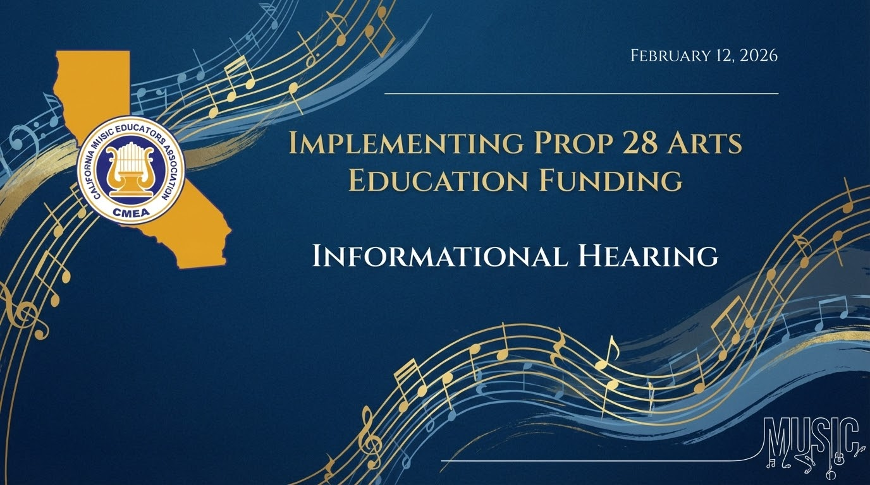

Slide 2
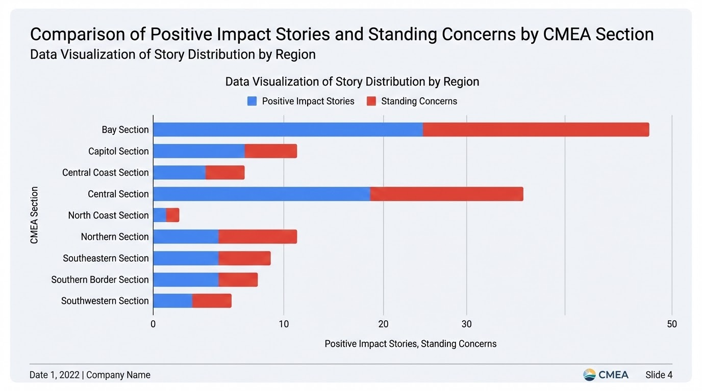

Slide 3
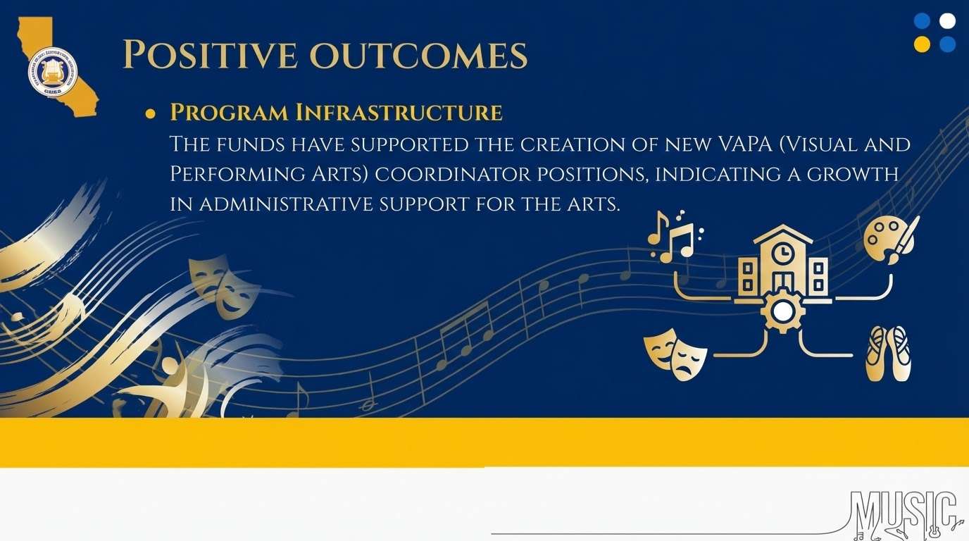

Slide 4
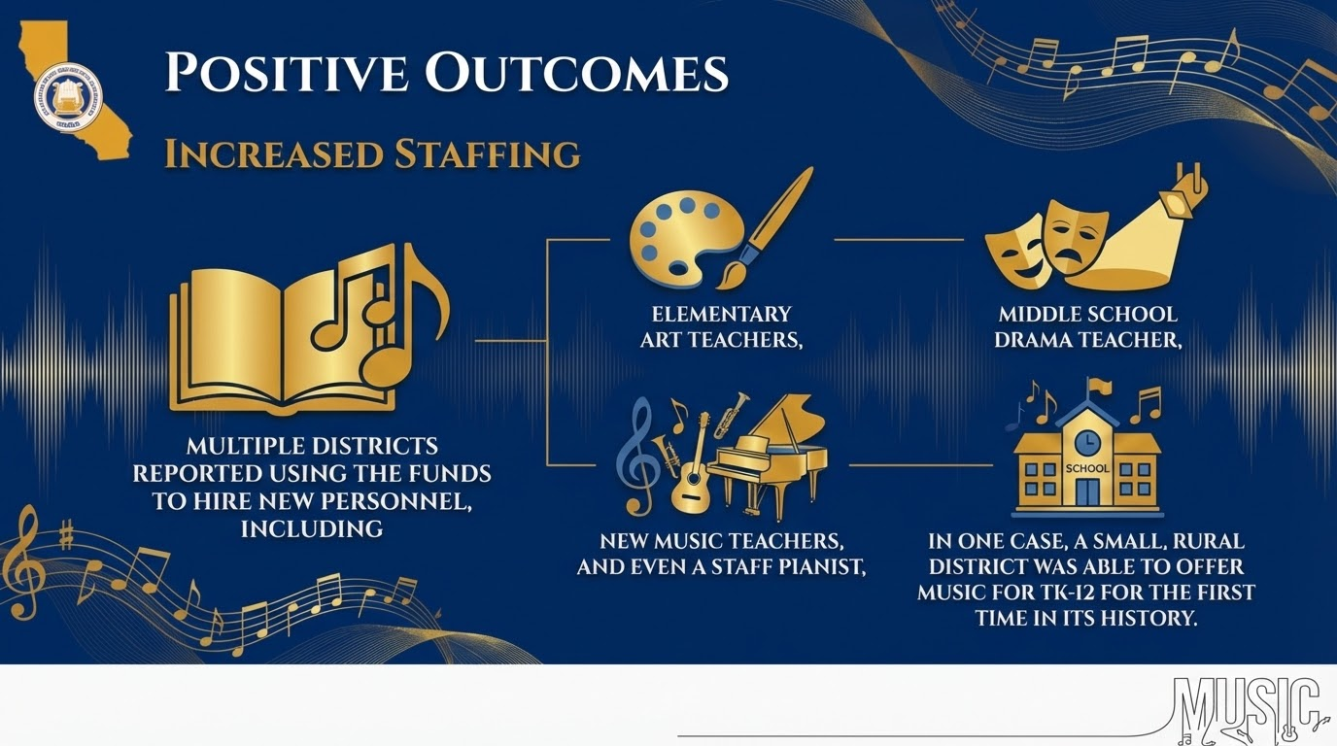

Slide 5


Slide 6
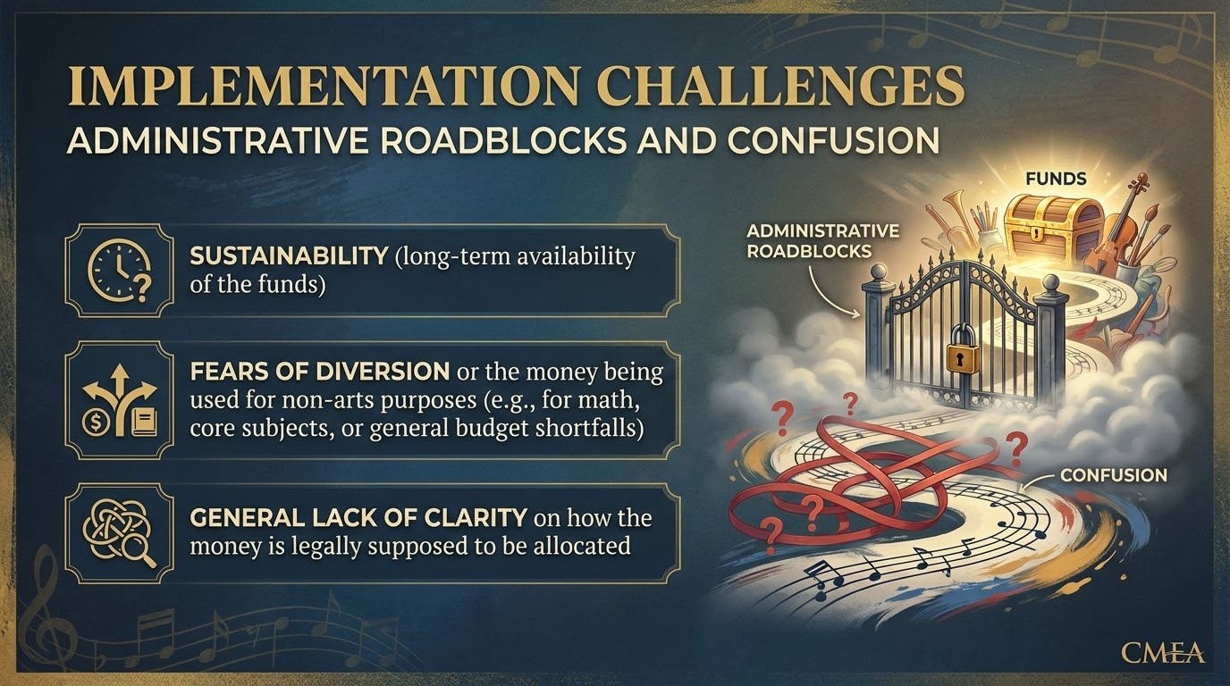

Slide 7
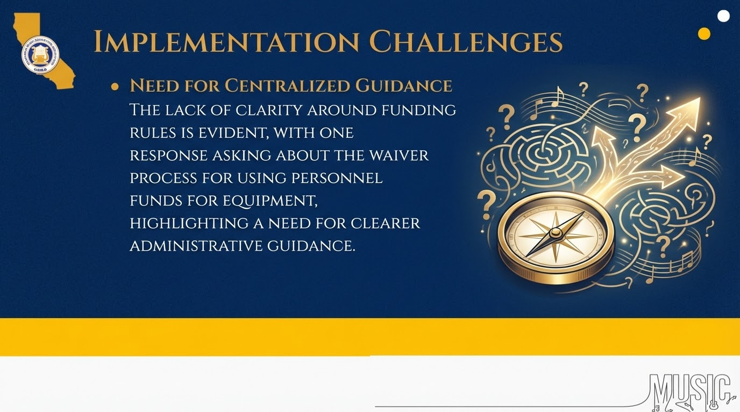

Slide 8





My primary standing concern is that AMS (Prop 28) funds may have been used to supplant rather than supplement existing arts and music funding. There is concern that Prop 28 funds have been applied toward covering current arts and music teaching positions that were previously supported through the general fund, rather than expanding or enhancing programs as intended by the legislation.
Additionally, there appears to be limited transparency and clarity at the site level regarding funding sources, staffing classifications, and how Prop 28 allocations were implemented. Without clear communication or an external audit, it is difficult for site educators to verify compliance with the supplement-not-supplant requirement or to understand how these funds have tangibly increased access, staffing, or resources for students. Greater transparency and accountability would help address these concerns and build trust in the implementation of Prop 28 funding.

Slide 9
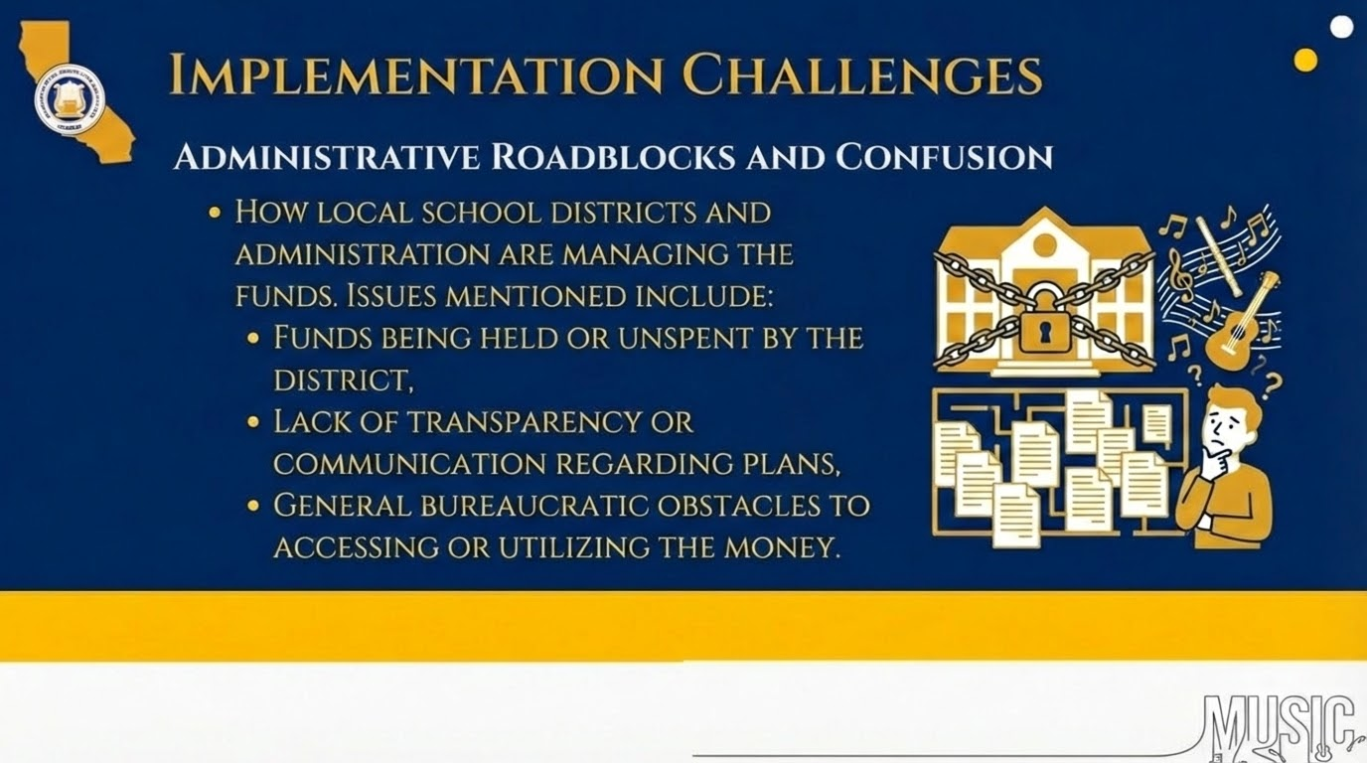

Slide 10
There is a lack of consistency from District to District and even school to school in how those funds are utilized. While there should be some adherence to traditional needs and support - if there are no pre-existing supportive pillars in place, it is likely the funding is being mis-directed or abused.
Within our district, for example, Admin. is using some of the funding to pay pre-existing stipends once built into the district budget (e.g. choir, band director, theater and dance stipends once paid by the district are now being paid through Prop 28).
The intent of Prop 28 is to not supplant pre-existing funding, but to further advance.

Slide 11
There is no one educating district admin or site admin on how prop 28 works and how to use it. They are the gatekeepers. Prop 28 money is going to waste or is being used and taken by admin for other purposes. This is not right, putting money for the arts into the hands of those who do not know how to use it.

Slide 12
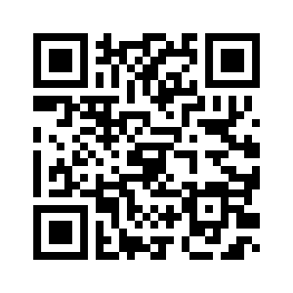
Arts and Music in Schools
CMEA Resource Page

