Slide 1
Research on Prop 28 Implementation
February 12, 2026
Preliminary Findings
Sharon Herpin, EdD

Slide 2

WestEd, a nonpartisan research, development, and service agency, works to promote excellence, improve learning, and increase opportunity for children, youth, and adults.
Our Mission

Slide 3
About the Data
10 interviews
18 attendees at in-person convening
462 respondents to a statewide survey

Slide 4
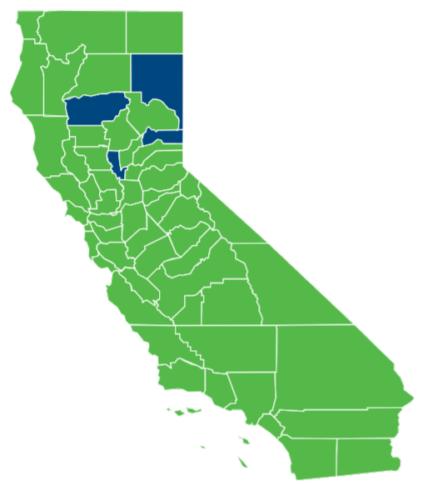
54 of 58 counties represented

Slide 5
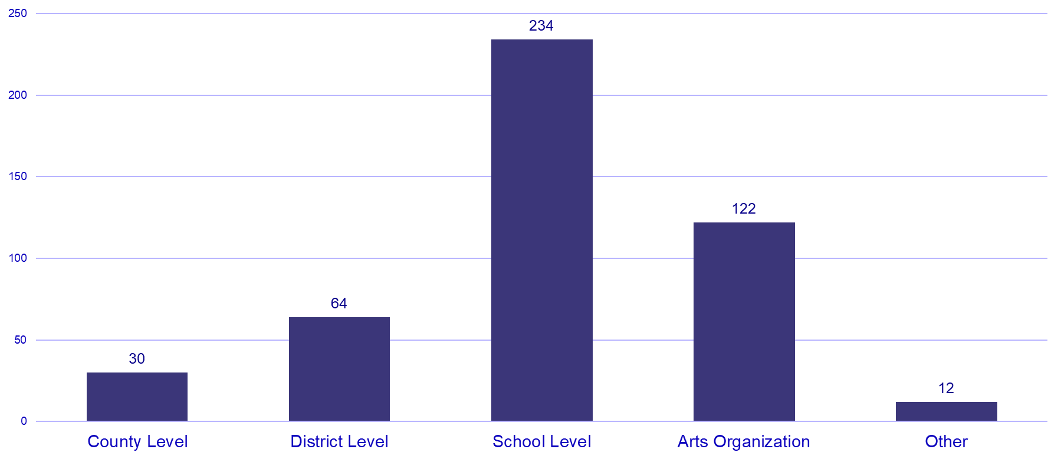
Survey Respondent Employment Type

Slide 6



Primary Uses of Prop 28 AMS Funds
Purchase Arts Supplies and Materials
Hire or Increase Time for Certificated Arts Educators
Provide Arts-based Field Trips

Slide 7



Participants Reported Moderate Positive Impacts
Increased Availability of Arts Supplies and Materials
Increased Discussions about the Arts
Expansion of Existing Arts Programs
More Students Receiving Arts Education
50% of participants reported Prop 28 has led to some increase in student participation in the arts

Slide 8
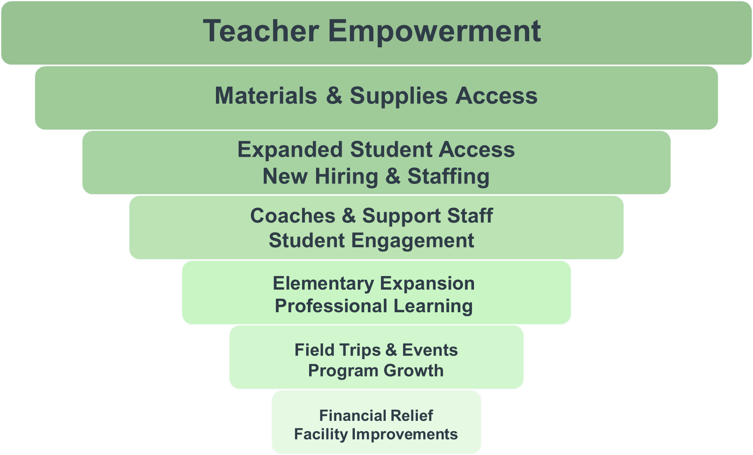
Qualitative Themes – Successes
"With Prop 28 funding we have been able to hire 12 itinerant arts teachers who now serve in our 17 TK-5 schools. This has been huge as it has allowed for us to go from 20% to 100% of our TK-5 students receiving regular arts instruction."

Slide 9
Challenges Varied by Participant Group
County | District | School
Inability to recruit and hire arts educators | Competing academic priorities | Limited knowledge about Prop 28
Lack of credentialed staff to teach the arts | Expected budget shortfalls | Lack of district support for arts education
Prop 28 funds are insufficient to meet instructional needs | Lack of credentialed staff to teach the arts | Expected budget shortfalls
Competing academic priorities | Lack of facilities/space to provide arts programming | Inability to purchase needed supplies and materials

Slide 10
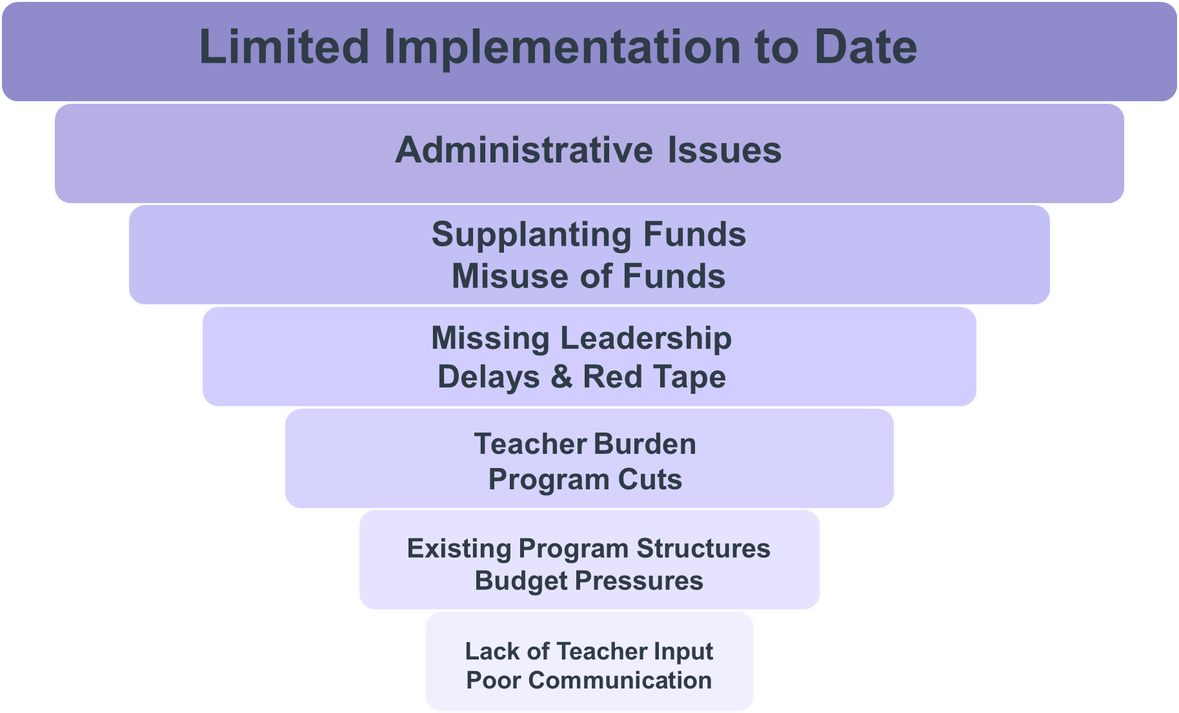
Qualitative Themes – Opportunities

Slide 11
Additional Themes
Funding Confusion– Need for clarity about allowable spending and supplanting
Staffing Difficulties – Need for more qualified arts teachers
80/20 Rule – Desire for more flexibility
Need for Leadership – Desire for VAPA coordinators and strategic planning
Scheduling & Access Guidance – Need support to overcome issues related to scheduling, limited space, and itinerant teaching burdens

